Slide 1
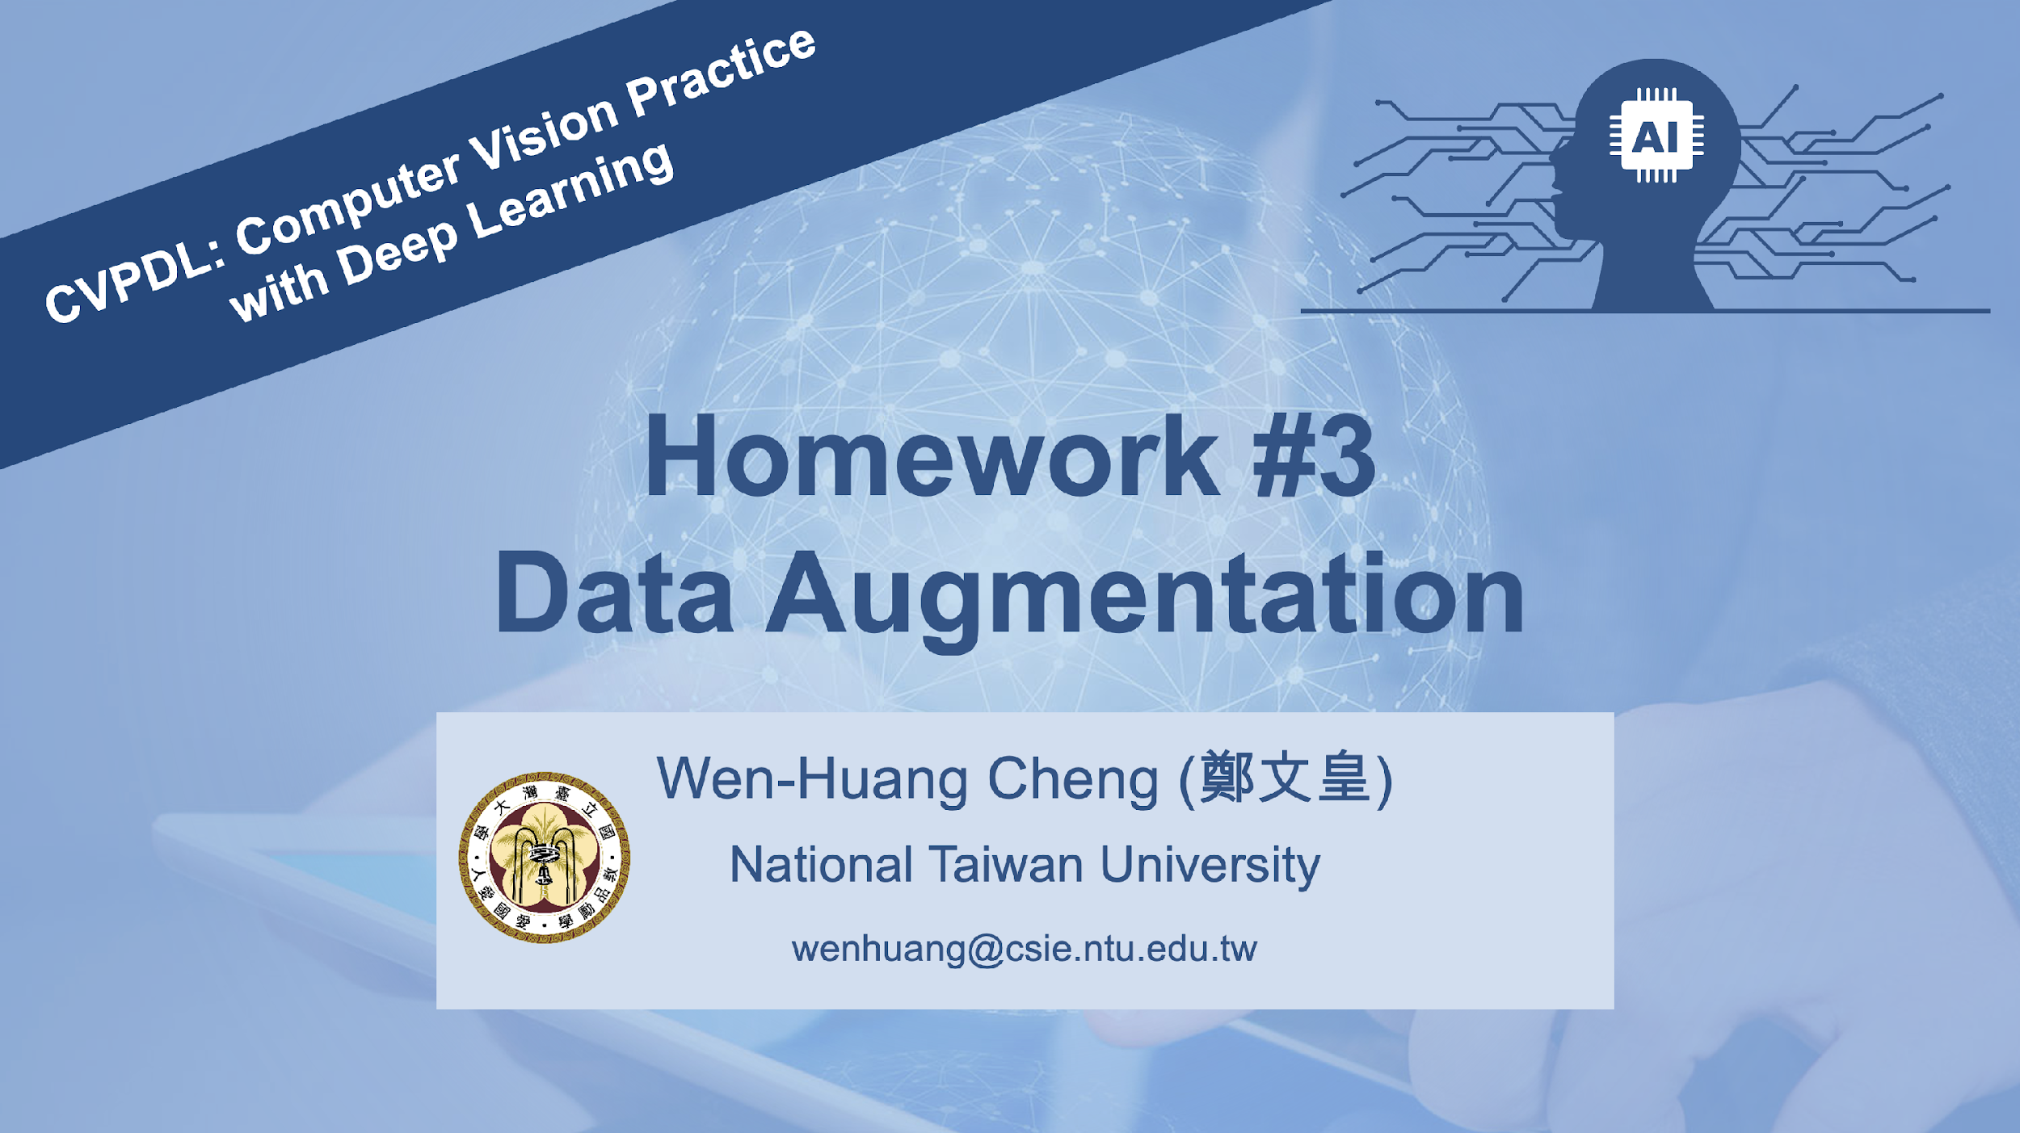

Slide 2
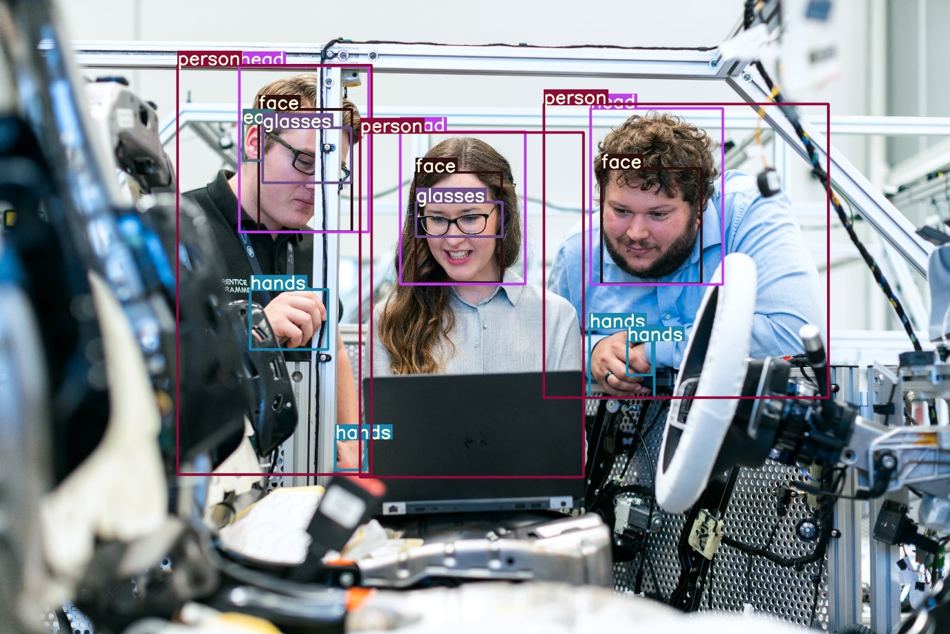
Recap: Object Detection
Object Detection
Input: 2D RGB image
Task: localization and classification
Output: N x [points, confidence]
Data imbalance:
There is an imbalance in the distribution of data across categories. Addressing this imbalance is crucial for developing effective and unbiased models.

Slide 3
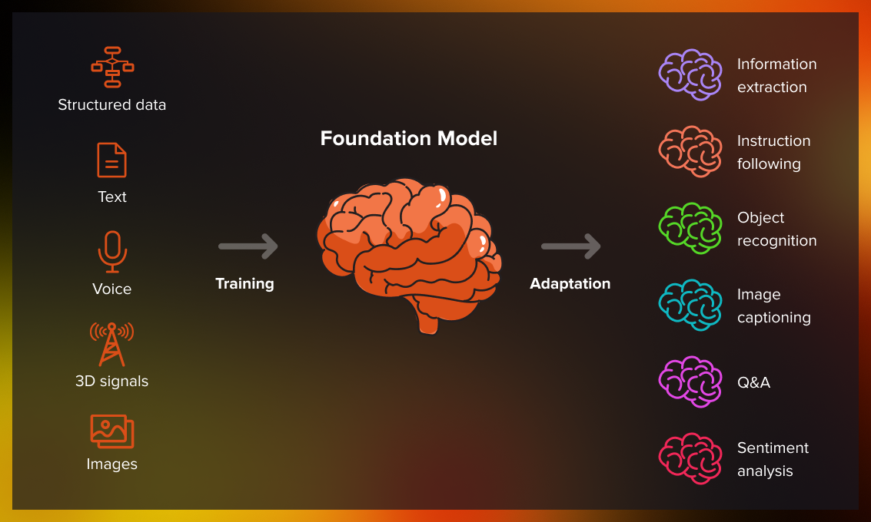
Background Information: Foundation Models
What are Foundation Models?
Large-scale, pre-trained models having been developed using vast amounts of data can be adapted to accomplish a broad range of tasks.
Examples:
BERT (Question Answering, Translation)
GPT (ChatGPT)
Claude (Programming)
Stable Diffusion (T2I Generation)
BLIP2 (Visual Question Answering)
…
https://serokell.io/blog/guide-to-foundation-models

Slide 4
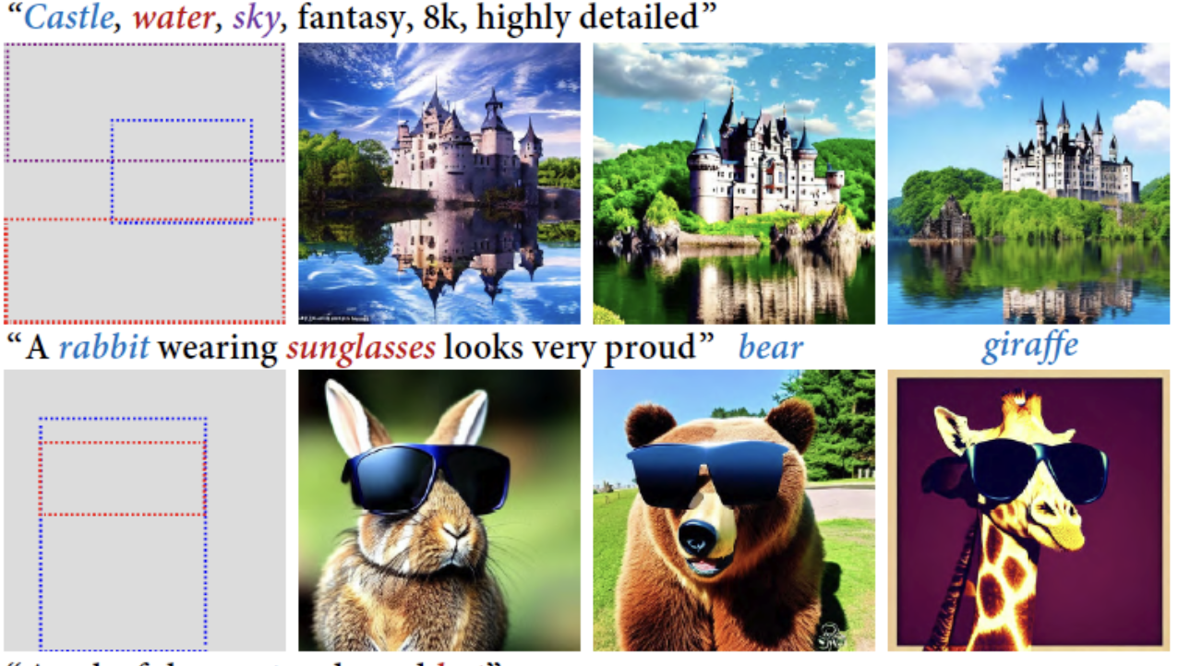
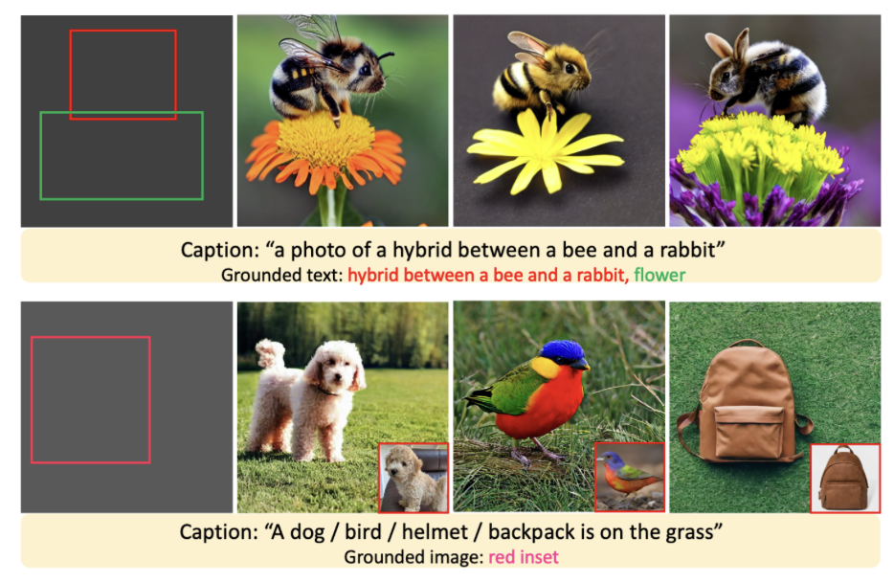
Background Information: Layout-to-Image methods
The current Stable Diffusion model relies on class labels or text prompts for conditioning. To enable precise control, such as positioning objects in a layout, methods like fine-tuning and cross-attention map adjustments have been developed.
BoxDiff (ICCV 2023)
GLIGEN (CVPR 2023)

Slide 5
Goals of HW3
We want to leverage two Foundation Models, BLIP2 and Stable Diffusion, to solve the imbalance problem of HW1_dataset.
Considering that Stable-diffusion-based methods require text prompts as inputs for generation, we can first generate prompts from the given dataset by the image captioning ability of BLIP2.
After obtaining text prompts for later image generation, one problem still needs to be solved. That is, object detection demands bounding boxes for training.
Thus, we utilize layout-to-image method to guide the Stable Diffusion model in generating objects in the regions defined by the bounding boxes from label.json.

Slide 6
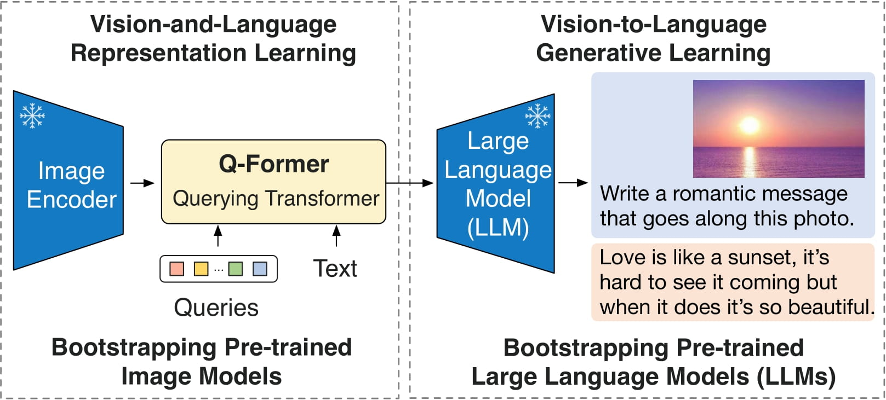
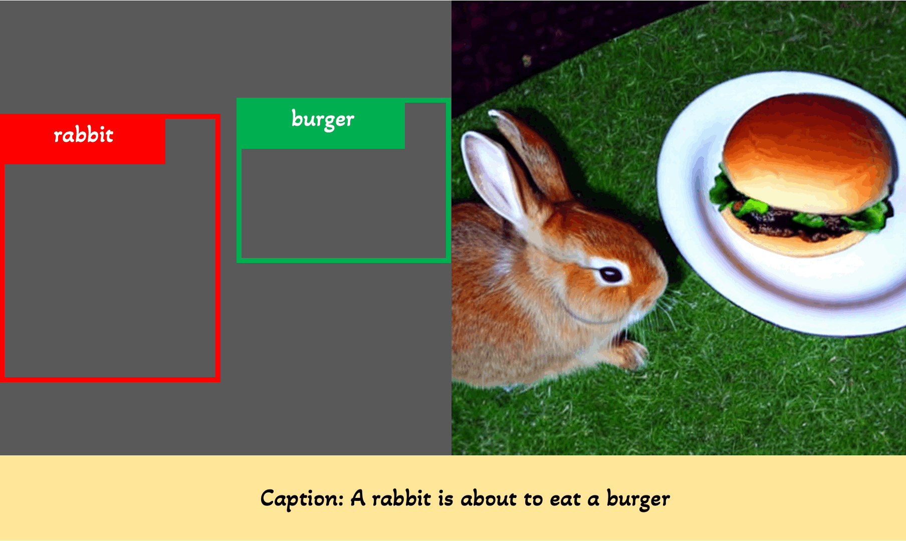
Data Augmentation by Foundation Model
Image Captioning
BLIP2
Data Augmentation
Layout2img methods ( e.g. GLIGEN, BoxDiff ...)
You can find some more advanced methods for implementation.
Illustration of Blip2
Illustration of GLIGEN

Slide 7

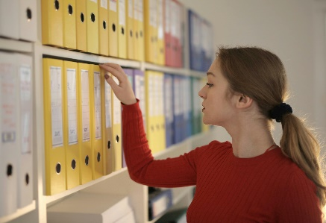


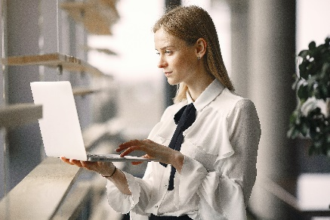
Pipeline Design
Objection Detection datasets
.
.
Augmented Images
.
.
BLIP2
Layout2img methods
caption

Slide 8
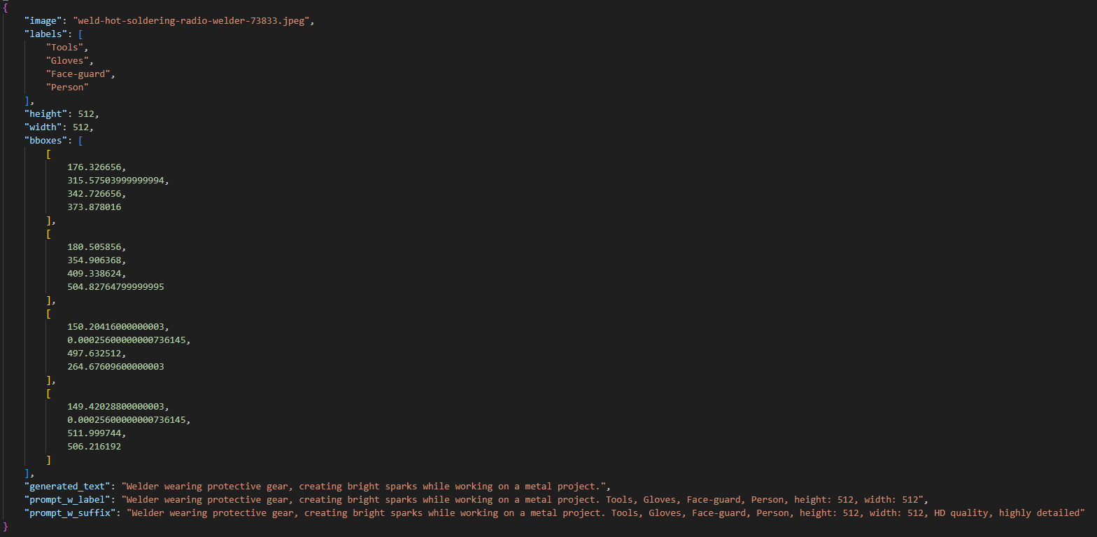
Stage 1: Image Captioning and Prompt Design
Perform captioning for the 2160 images corresponding to label.json and design various prompt templates.
bboxes are adjusted to match the size of the 512x512 image and are saved in [x_min, y_min, x_max, y_max] format.
Model Zoo
Sample Code
Examples of image captioning and different prompt designs.

Slide 9
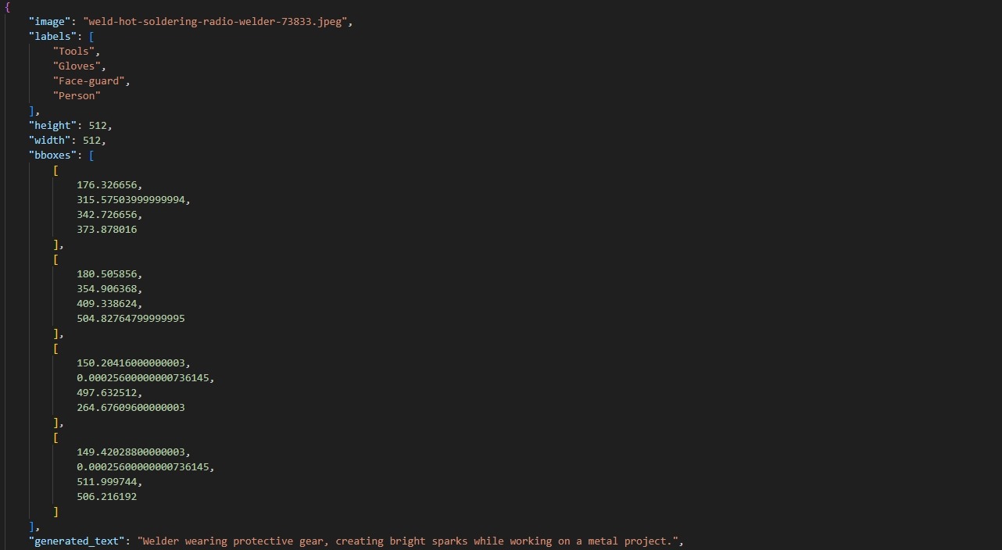
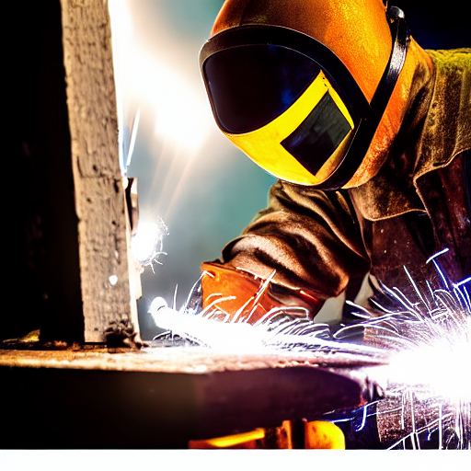
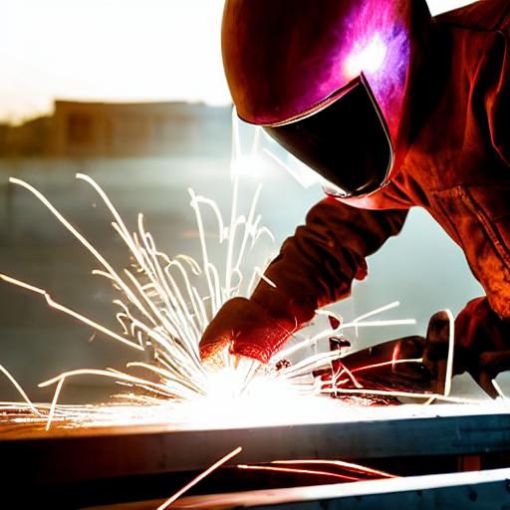
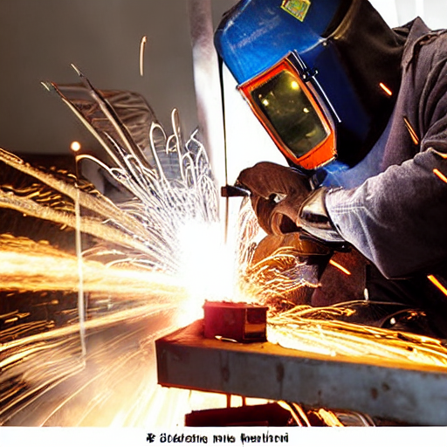
Stage 2: Text-to-Image Generation for Data Augmentation
Perform data augmentation using different prompts and incorporate additional layouts.
Sample Code
Examples of Text-to-Image Generation using GLIGEN

Slide 10
Evaluation Metrics
1. Fréchet inception distance (FID)
Please perform the evaluation yourself using this function. ( Notes: Resize the image to 512x512 first when computing FID. If you encounter ValueError: Imaginary component, just downgrade scipy to 1.11.1.)
Measure FID for 2160 images generated based on ` label.json ` (under three different settings).

Slide 11
Evaluation Metrics
2. Mean Average Precision
AP at IoU = [50:5:95]
Please submit the images generated corresponding to `visualization_200.json`.
The TAs will evaluate the mAP score to verify the effectiveness of the layout-to-image generation process.

Slide 12
Homework Requirements
Image Captioning and Prompt Design
Compare the performance of 2 selected different pre-trained models in generating captions, and use the one you find the most effective for later problems. (Suggestion: choose models wisely based on VRAM size)
Salesforce/blip2-opt-2.7b
Salesforce/blip2-opt-6.7b-coco
Salesforce/blip2-opt-6.7b
Salesforce/blip2-flan-t5-xl
Design 2 templates of prompts for later generating comparison
For example, you can add labels or additional suffixes to the prompt. Refer to the examples provided on p.8 for guidance.
The existing prompt template corresponds to “generated_text”, "prompt_w_label", and "prompt_w_suffix". You are free to fill in or modify them as needed.

Slide 13
Homework Requirements
2) Text-to-Image Generation
Use 2 kinds of generated prompts from Problem 1(b) to generate images. (text only!)
Select the prompts for better-generating results, and perform layout-to-image generation.
text+layout / text+layout+reference image(optional)
Freely choose different layout-to-image methods.

Slide 14
Submission Guideline
The report should include the following:
The selected relevant papers, methodologies used, prompt design, and implementation steps.
A table presenting performance metrics based on FID.
 | Text grounding |  | Layout-to-Image
prompt | Template #1 | Template #2 | Template #?
FID

Slide 15
Submission Guideline
Images to be submitted:
Generate one image for each example in 'visualization_200.json,’
Use your own prompt design and the chosen layout-to-image method
Adding a reference image as input is okay
Save all generated images in the 'generation' folder for submission to NTU COOL.
The TAs will measure the mAP of these images

Slide 16
Grading
Report (70%)
Image Captioning and Prompt Design (30%)
(a) 10% (5% / Blip-2 model)
(b) 20% (10% / Prompt template)
Text-to-Image Generation(40%)
10% / column1 10% / column2 20% / column3
Submitted Images (30%)
The TAs will calculate the mAP. The results will then be used to rank performance, determining the final grade.

Slide 17
Submission
Deadline : 2024/12/15 (Sun.) 23:59
Zip all files as hw3_<student_id>.zip
Submit a zipped file (hw3_<student-id>.zip) on NTU COOL containing:
hw3_<student-id>.zip |-- hw3_<student-id> (Should contain this folder, not separate files) |-------- hw3_<student-id>.pdf (Your report) |-------- generation |-------- |-------- (Place the specified 200 generated images here) |-------- Codes for inference |-------- README file

Slide 18
Helps
Mail
If you have any questions, contact TAs via this email
cvpdl.ta.2024@gmail.com
Please note that emails sent to TA’s personal email address will not receive responses.

Slide 19
Any Question
cvpdl.ta.2024@gmail.com

